Slide 1

Common People Issues
Unit 4
By: Anand C Unakal

Slide 2
PERCEPTIONS AND MISCONCEPTIONS ABOUT TESTING
“Testing is not Technically Challenging”

Slide 3
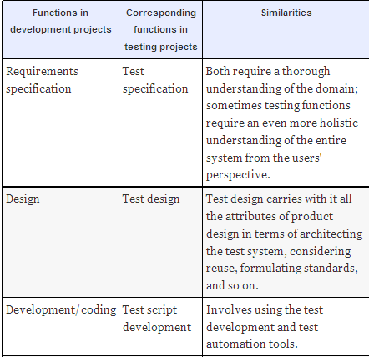
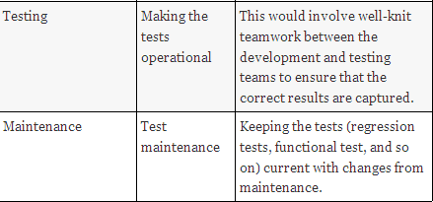
“Testing is not Technically Challenging”

Slide 4
Requires a holistic understanding of the entire product rather than just a single module
Typically, development engineers tend to focus on specific modules. It is possible for them to be somewhat oblivious about the functionality from other modules.
Test engineers, in contrast, generally require a more holistic understanding of the product rather than be constrained to a single module or component.
This gives an edge to test engineers at becoming domain specialists.

Slide 5
2. Requires thorough understanding of multiple domains
As the products become more complex and more open and seamlessly integrated with one another, testing requires a deep appreciation of the domains of multiple products.
Testing may even require a much deeper understanding of the interactions and inter-dependencies amongst multiple domains to be able to simulate real-life scenarios.
Thus, testing seems to be even more suited to and challenging for someone who has expertise in product domains.

Slide 6
3. Specialization in languages
Most developers stake their claim at expertise by gaining proficiency in some specific programming language(s) or platform(s).
In the early 1990s, most people sought to be experts in C, which moved to C++ and then to Java. Most testing was either manual or used some home-grown tools.
The advent of specialized testing languages and tools over the past few years has narrowed this gap about language expertise in testing.

Slide 7
4. Use of tools
Testing functions offered very little opportunity for using tools. Again, things have changed significantly on this front over the last few years.
The standard testing tools available in the market not only support languages that are akin to programming languages, but also provide opportunities for better design and integration with the program code of the product being tested.
Given the complexity of tools, sometimes, automating the tests can prove to be more challenging than even developing the code for the product!

Slide 8
5. Opportunities for conceptualization and out-of-the-box thinking
Since testing is viewed as a “destructive” job, there is a perception that there are more opportunities for conceptualization in development functions than in testing functions.
Even though testing is considered destructive (in the sense of finding defects in a product), these similarities are enough proof that there are ample opportunities for conceptualization and out-of-the-box thinking.
Unfortunately, these similarities most often get completely overlooked by people in seeking a career in testing.

Slide 9
6. Significant investments are made in testing today—sometimes a lot more than in development
For instance, testing tools are very expensive and obviously, an organization would have to ensure that there is sufficient return on investments on these expensive tools.
Hence, it is eminently possible that some of the best talent gets channelled to testing functions.

Slide 10
7. An internal test tool today could very well be one of those expensive test automation tools of tomorrow!
In many organizations, what starts off as an internal tool within a small group expands to be a sizable product, with ramifications and applicability across multiple groups and from there to even becoming a revenue-earning test automation product.
In view of all of the above, testing offers sufficient technical challenges for an interested professional to continuously learn, enrich his or her knowledge, and achieve greater heights of personal satisfaction as well as product quality and fulfilment.
“there is testing in all development and development in all testing”.

Slide 11
“Testing Does Not Provide Me a Career Path or Growth”
From a project life cycle point of view, developers seem to have a natural progression into being a designer, a business analyst, and a domain expert. There is also scope for being a respected “architect.”
Testing organizations do not always present such obvious opportunities for career growth. This does not mean that there are no career paths for testing professionals.
Since we strongly believe that there is an equally lucrative career path for testing professionals, we will revisit this statement and devote the entire next section fully to address the career path choices for testing professionals.

Slide 12
“I Am Put in Testing—What is Wrong With Me?!”
Filling up positions for testing should not be treated as a second string function. If the hiring and allocation policy is such that all the “toppers” in a class (or the candidates from top schools) are allocated to development functions and testing functions get the “leftovers,” then obviously the management is sending the wrong signals and reinforcing the wrong message.
A person should be assigned to testing only when he or she has the right aptitude and attitude for testing. They should see a career path in testing, as much as developers look for a career path in development.

Slide 13
“These Folks Are My Adversaries”
Since the main function of testing is to find defects in the products, it is easy for an adversary attitude to develop between the testing team and the development team.
The development team start viewing the testing team as people who nitpick their work, while testing teams begin viewing the development teams as giving them products that are not ready for prime time.
Testing and Development teams should reinforce each other and not be at loggerheads.

Slide 14
“Testing is What I Can Do in the End if I Get Time”
When deadlines are considered most of the times the testing team receives the product late ,the time allocated to testing gets cut and testers often have to put in long hours spanning weekends to meet the deadlines, while ensuring that the product is tested "adequately." After all, when customers report problems, the first question asked is "Why wasn't this defect caught in testing?!"
Some ways of overcoming this problem are
Stipulating completion/acceptance criteria for a testing team to accept a product from the development team.
Giving the testing team the freedom to mandate a minimum quality in the product before it can be released.

Slide 15
“There is No Sense of Ownership in Testing”
When we talk of team structures for product development, we often see roles like "module leader." These are often people who have ownership of the module that is being developed. Even in the maintenance phase, there is ownership at module level or component level. This ownership creates a pride that drives individuals to ensure better quality.
This ownership is sometimes not created for testing functions. A possible contributor to this feeling of lack of ownership is the apparent lack of "deliverables" for testing functions. Lack of direct customer exposure of these artifacts does put a damper on the mindset of the testing professionals.

Slide 16
"Testing is Only Destructive"
There is a perception is that test engineers are only working towards "breaking the software" or testing to prove "the product doesn't work.“ This is not entirely true.
The test engineers not only say "something doesn't work," they also point out "what works" in the product.
The job of testing is a combination of pointing out what works in the product, "breaking the software" and analyzing the risk of releasing the software with the defects. The balance among these perspectives brings a positive mindset to the test engineer.

Slide 17
COMPARISON BETWEEN TESTING AND DEVELOPMENT FUNCTIONS
The perceptions and misconceptions discussed above arise because of some significant differences between testing and development functions.
Testing is often a crunch time function:
Generally more "elasticity" is allowed in projects in earlier phases:
Testing functions are arguably the most difficult ones to staff:
Testing functions usually carry more external dependencies than development functions

Slide 18
Providing Career Paths For Testing Professionals
When people look for a career path in testing (or for that matter in any chosen profession), some of the areas of progression they look for are
Technical challenge;
Learning opportunities;
Increasing responsibility and authority;
Increasing independence;
Ability to have a significant influence on an organization's success; and
Rewards and recognition.

Slide 19
Stages in testing career:
The first stage is the follow stage: At the beginning of this stage, the trust and confidence level between the individual and the organization just starts to evolve. At this stage of their career, they have fairly detailed instructions on what tasks they have to do and how they should go about carrying out the defined tasks. Thus at this stage, the work
Is fairly task oriented;
Comes with detailed instructions; and
Leaves little requirement for decision making.

Slide 20
Formulating stage:
At this stage of the career, there is an increased focus on
Independent decision making;
Clarity in communication to assign work for others; and
Interacting with other groups.
Influencing stage
Following stage

Slide 21
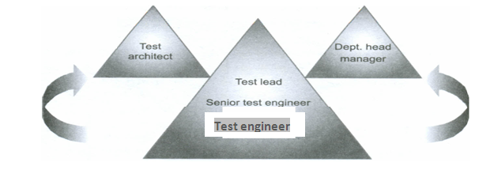
Career progression for testing professionals :Test engineer

Slide 22
Test engineers
Senior test engineers
Test lead
Dept head manager
Test architect

Slide 23
The Role Of The Ecosystem And A Call For Action
The perceptions, misconceptions, and issues discussed so far cannot all be corrected by each and every organization individually. There are collective and much higher-level actions that need to be done. We will look at some of these issues in this section and present a call for action that is required from each of these constituents.
Role of education system :
The education system does not place sufficient emphasis on testing. Consider some of these facts about what prevails in most universities.
There are formal core courses on programming but only a few universities offer core courses on software testing.
There are "lab courses" for various development tools but none or very few for common testing tools.

Slide 24
2. Role of senior Management
Ensuring a fair distribution of appropriately talented people in the testing area
Not allowing development engineers to look down upon test engineers.
Encouraging and consciously ensuring that there is active job rotation among development, testing, and support functions. Such job rotation will increase the cohesion in the organization and minimize the chances of testers being "looked down upon."
Demonstrating equity in recognition and reward schemes to the top performers in all the functions, including testing.

Slide 25
3. Role of the Community:
Testers should start with a sense of pride in their job and the realization of their role in a more holistic way, in the bigger picture of the entire product.
Testers should themselves see a career in testing rather than view testing as a stopgap arrangement or a means to get into development functions, Hopefully, the career paths outlined in the previous section will motivate people to take up testing as a career.
Test engineers need not be just followers of technology - they can take an active part in shaping and using new technology..

Slide 26
An example to elaborate the meaning of above points:
There were three workers working at a construction site.
A passer-by asked the first worker, “What are you doing?”
“Phew, I am just slogging along, as it is my fate”, replied the worker.
The passer-by posed the same question to the second worker. “I am breaking stones”, the second worker replied.
Then the passer-by asked the third worker the same question.
The third worker replied enthusiastically, “I am helping build a cathedral that will soon come up at this site!”
The first worker is like a tester looking at testing as a stopgap arrangement, blaming his fate for not getting into a development job. The second worker is like a person who does testing but does not see its relevance.
The final worker is the one who sees the value in his work and understands the big picture.

Slide 27
ORGANIZATION STRUCTURE FOR TESTING TEAMS

Slide 28
DIMENSIONS OF ORGANIZATION STRUCTURES
The study Organization structure is important in terms of effectiveness because an appropriate designed organization structure can provide accountability to results.
Organization structures provide a direction for team members to envision their career paths.
Organization structures are classified into two dimensions. i.e. first dimension is organization type and second is geographical distribution.
Organization structures are broadly classified into 2 categories- Product and Services organization.

Slide 29
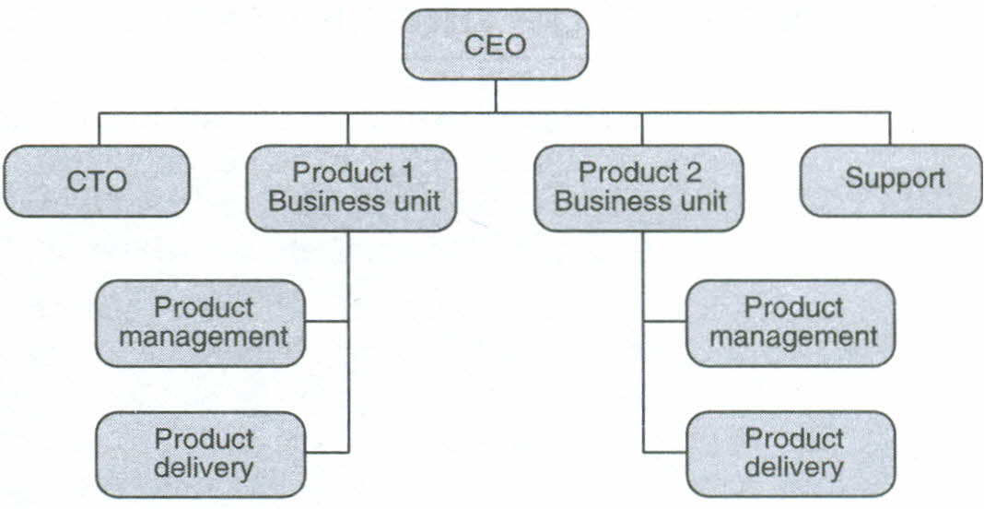
STRUCTURES IN SINGLE-PRODUCT COMPANIES
Product companies in general have a high-level organization structure similar to the one shown in Figure
Organization structure of a multi-product company.
Figure 14.1 shows a typical multi-product organization. The internal organization of the delivery teams varies with different scenarios for single- and multi-product companies, as we will discuss below.

Slide 30
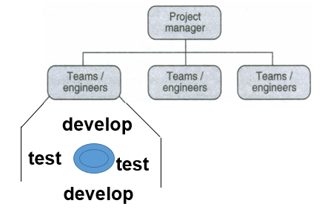
Testing Team Structures for Single-Product Companies:
This model offers some advantages that are well suited to small organizations.

Slide 31
Exploits the rear-loading nature of testing activities
Enables engineers to gain experience in all aspects of life cycle
Is amenable to the fact that the organization mostly only has informal
Some defects may be detected early
Accountability for testing and quality
Developers do not in general like testing and hence the effectiveness of testing suffers
Schedule pressures generally compromise testing

Slide 32
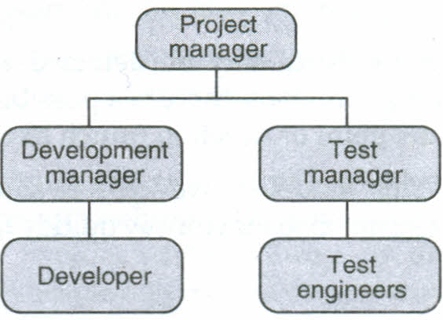
Developers may not be able carry out the different types of tests : In this model, some of the disadvantages of the previous model are done away with , a homogeneous single-product organization doing both development and testing, splits into two distinct groups, one for development and one for testing.
Figure 14.3 Separate groups for testing and development.

Slide 33
Component-Wise Testing Teams:
Even if a company produces only one product, the product is made up of a number of components that fit together as a whole. In order to provide better accountability, each component may be developed and tested by separate teams and all the components integrated by a single integration test team reporting to the project manager.

Slide 34
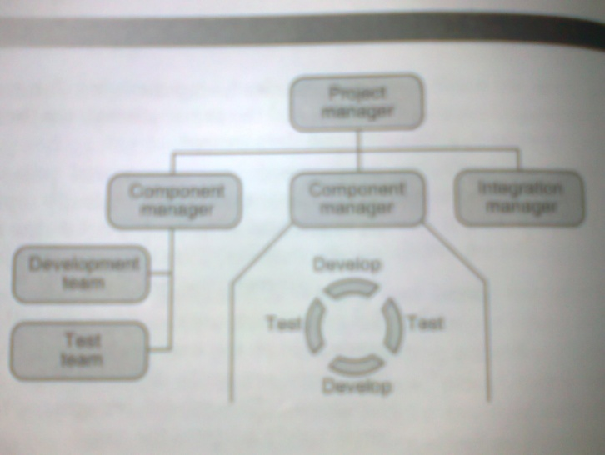
Structures For Multi-Product Companies:
When a company becomes successful as a single-product company, it may decide to diversify into other products. In such a case, each of the products is considered as a separate business unit, responsible for all activities of a product.

Slide 35
The organization of test teams in multi-product companies is dictated largely by the following factors.
How tightly coupled the products are in terms of technology
Dependence among various products
How synchronous are the release cycles of products
Customer base for each product and similarity among customer bases far various products

Slide 36
Based on the above factors, there are several options available for organizing testing teams for a multi-product company.
A central "test think-tank/brain trust" team, which formulates the test strategy for the organization
One test team for all the products
Different test teams for each product (or related products)
Different test teams for different types of tests
A hybrid of all the above models

Slide 37
Testing Teams as part of “CTO’s Office”
The advantages that this model brings to the table are as follows.
Developing a product architecture that is testable or suitable for testing.
The testing team can even make valuable contributions to product and technology choices.
The testing team can get a clear understating of what design and architecture are built for and plan their tests accordingly
The technical road map for product development and test suite development will be in better sync.
The C'I'O's team can evolve a consistent, cost-effective strategy for test automation.

Slide 38
2. Single Test Team for All Products
This model is similar to the case of a single-product team divided into multiple components and each of the components being developed by an independent team.
The one major difference between the two is that in the earlier model, the project manager to whom the testing teams reports has direct delivery responsibilities whereas in the case of a multi-product company,
since different groups/individuals have delivery responsibilities for different products, the single testing team must necessarily report to a different level.

Slide 39
3. Testing Teams Organized by Product
The most natural and effective way to organize the teams is to assign complete responsibility of all aspects of a product to the corresponding business unit and let the business unit head figure out how to organize the testing and development teams.
This is very similar to the multi-component testing teams model.
Depending on the level of integration required among the products, there may be need for a central integration testing team.
This team handles all the issues pertaining to the integration of the multiple products. Such an integration team should be cross-product and hence ideally report into the CTO think-tank.

Slide 40
4. Separate Testing Teams for Different Phases of Testing
So far, we have viewed "testing" as a single, homogeneous activity. In reality, however, it is not so.
We have seen that there are different types of testing that need to be done-such as black box testing, system testing, performance testing, integration testing, internationalization testing, and so on.
We have also seen that the skill sets required for performing each of these different test types are quite different from each other.
Each of these different types of tests may be carried out at different points in time

Slide 41
Such an organization based on the testing types presents several advantages.
People with appropriate skill sets are used to perform a given type of test.
Defects can get detected better and closer to the point of injection.
This organization is in line with the V model and hence can lead to effective distribution of test resources.

Slide 42
5. Hybrid Models
The above models are not mutually exclusive or disjoint models. In practice, a combination of all these models are used and the models chosen change from time to time, depending on the needs of the project.
We would like to view the various organization structures presented above as simply building blocks that can be put together in various permutations and combinations, depending on the need of the situation.
The main aim of such hybrid organization structures should be effectiveness without losing sight of accountability.

Slide 43
EFFECTS OF GLOBALIZATION AND GEOGRAPHICALLY DISTRIBUTED TEAMS ON PRODUCT TESTING
Business Impact of Globalization
Globalization has revolutionized the way we produce and maintain software products.
Markets for software products are becoming global. Hence, a global distribution of production of software becomes necessary to exploit the knowledge of the local conditions.
Since the markets are global, the needs that a product must satisfy are increasing exponentially. Hence, it is impossible to meet all the demands from resources from just one location.

Slide 44
2. Round the Clock Development/Testing Model
The basic premises that drive this model are as follows.
Development and testing happen alternately and iteratively, that is a piece of code is developed, tested, and defects removed. This cycle continues until the testing is deemed complete.
Since development and testing alternate, it may be possible to perform development during one part of the day and testing during the other part.
The geographic time difference between two different locations can be exploited to "stretch" the day so that effectively work can be carried on during the night of one location, which is actually day for another location.

Slide 45
3. Testing Competency Center Model
In this model, a logical organization called the Testing Competency Center is created. This organization could potentially span multiple locations to effectively exploit time difference and/or available skill sets.
In the first variant, the Center is a shared (and often scarce) resource that is shared across multiple product development groups. This model is not to exploit the time zone advantages.
Another variant of the Testing Competency Center is to have a set of dedicated testing resources that gets involved in the full cycle of testing activities, right from the early stages of the project.

Slide 46
4. Challenges in Global Teams
Cultural challenges
Work allocation challenges
3. Parity across teams: Some of the ways to address this challenge are
Providing challenging job content;
Increasing career opportunities in testing, with models like competency centers;
Providing long-term retention incentives like stock options; and
Providing travel opportunities.

Slide 47
4. Ability to track effectively
5. Dependence on communication infrastructure
6. Time difference

Slide 48
TESTING SERVICES ORGANIZATIONS
Business Need for Testing Services:
Today it is common to find testing activities outsourced to external companies who specialize is testing and provide testing services.
There are several business drivers for this model of testing as a service.
Testing is becoming increasingly diverse and a very specialized function.
The variety and complexity of the test automation tools further increase the challenge in testing. A specialized testing service organization may be able to effectively fulfill such a niche need.
Testing as a process is becoming better defined.
An outsourced organization can offer location advantages. Testing teams that exist in different time zones can provide a better round-the-clock coverage.
An outsourced organization can provide cost advantages. Certain locations can be more economical than others, thus, the overall costs can be reduced.

Slide 49
2. Differences between Testing as a Service and Product- Testing Organizations
Organization structures and the associated people issues in a testing services organization are driven by certain fundamental factors:
Testing service organizations are generally held at arm's length from product developers : In a typical product development organization (where testing is one of the functions), there is a much closer binding between the development and testing teams, as people generally move from one group to another.
Testing service organizations may not always provide full breadth of coverage for testing types: Most testing service organizations provide services like black box testing, domain testing, and certain specialized testing such as performance testing or test automation. White box testing is not one of the commonly outsourced types of tests.
Testing service organizations tend to be more homogeneous in terms of job titles and roles than testing teams in product organizations : In a typical product organization, there is a variety of job functions-development, maintenance, testing, support, and so on. Since a testing services company focuses only on testing, the role definitions and job titles tend to be more homogeneous. services.

Slide 50
3. Typical Roles and Responsibilities of Testing Services Organization
The account manager serves the following functions.
Is the single point of contact between the customer and the testing services organization for all matters and is also the point of escalation.
Develops rapport with the customer and is responsible for ensuring that current projects are delivered as promised and for getting new (repeat) business from the customer.
Participates in all strategic (and tactical, as needed) communication between the customer and the testing services organization.
Acts as a proxy for the customer within the testing services organization.

Slide 51
4. Challenges and Issues in Testing Services Organizations
All testing organizations face certain common challenges
The outsider effect and estimation of resources: The testing services organization is an "outsider" to the development organization. Some of the implications are as follows.
They do not necessarily have access to the product internals or code
They do not have access to product history in terms of which modules have historically been problem prone and thus may not have all the information needed to plan and prioritize test cases.

Slide 52
Domain expertise: A testing team in a product organization can develop domain expertise in a specific domain
3. Privacy and customer isolation issues
4. Apportioning hardware and software resources and costs
5 . Maintaining a "Bench“

Slide 53
Success Factors For Testing Organizations
Whether it is product testing organizations or testing services organizations, there are some common success factors between them. These are as follows.
Communication and teamwork
Bringing in customer perspective
Providing appropriate tools and environment
Providing periodic skill upgrades

Slide 54
Thank You

